Slide 1
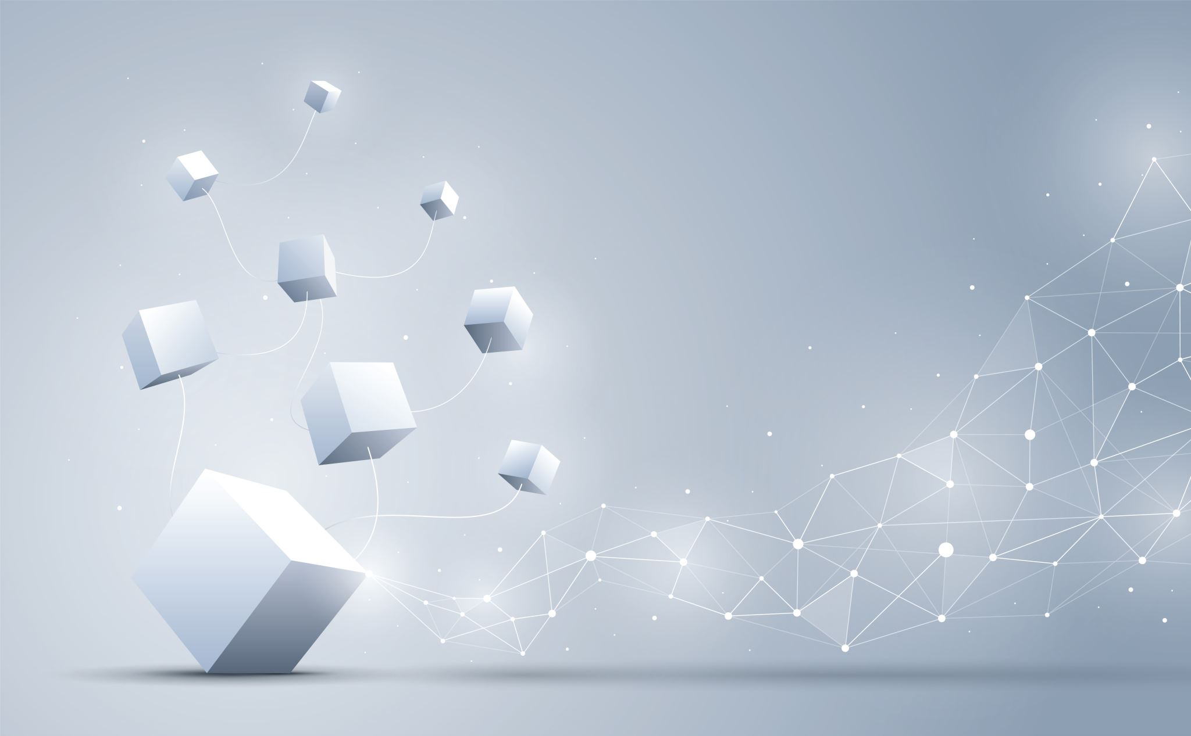
AUTONOMOUS DRIVING
Group Members: Chaofu Zhang, Qianhui Cen, Yuan Le

Slide 2
Content Table
Background
Dataset
EDA
Experimental Setup
Deep Learning Network
Results
Summary and conclusion

Slide 3
Background
Problem: how to predict autonomous driving
To do:
build an algorithm to estimate the 6 poses of vehicles from one picture in real-world traffic environment and anticipate how a vehicle would do autonomous driving based on the analysis of the surroundings(positions of nearby automobiles)
Motivation: explore the truth of autonomous driving and try to find out how to improve self-driving to make it wide-spread.

Slide 4
Dataset
Dataset: autonomous driving from Peking University
https://www.kaggle.com/c/pku-autonomous-driving
Images:6283 real-world images (train: 4220/ test: 2063)
Pose Information: model type, yaw, pitch, roll, x, y, z (string type)
Image Masks: binary
Car Models: over 60000 labeled 3D cars
Camera Information: camera intrinsic parameters

Slide 5
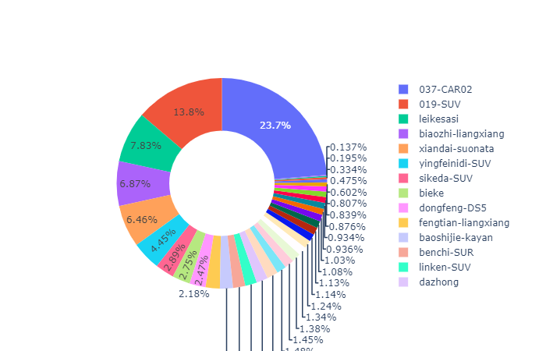
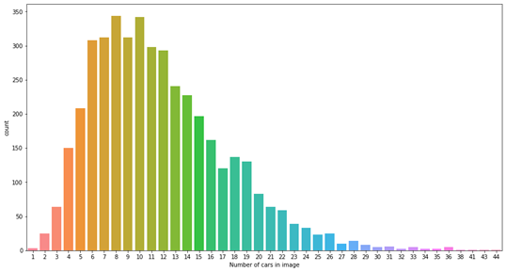
EDA

Slide 6
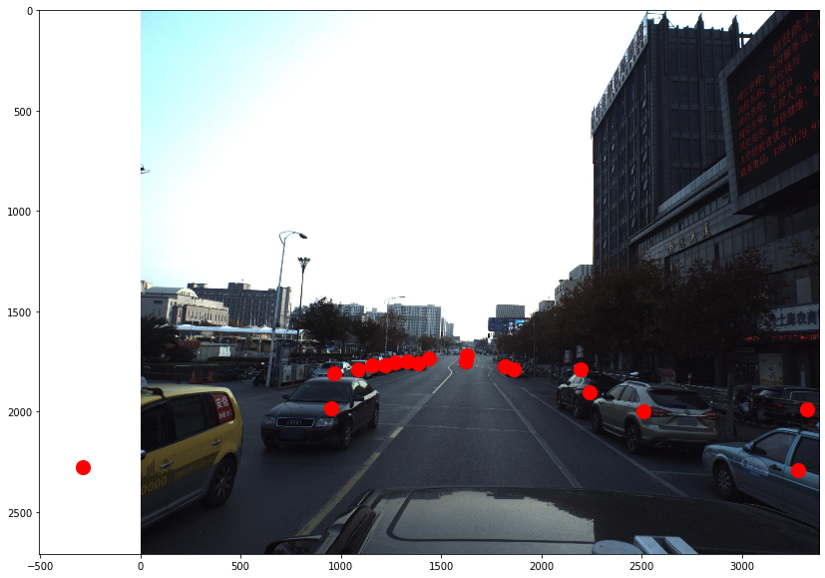
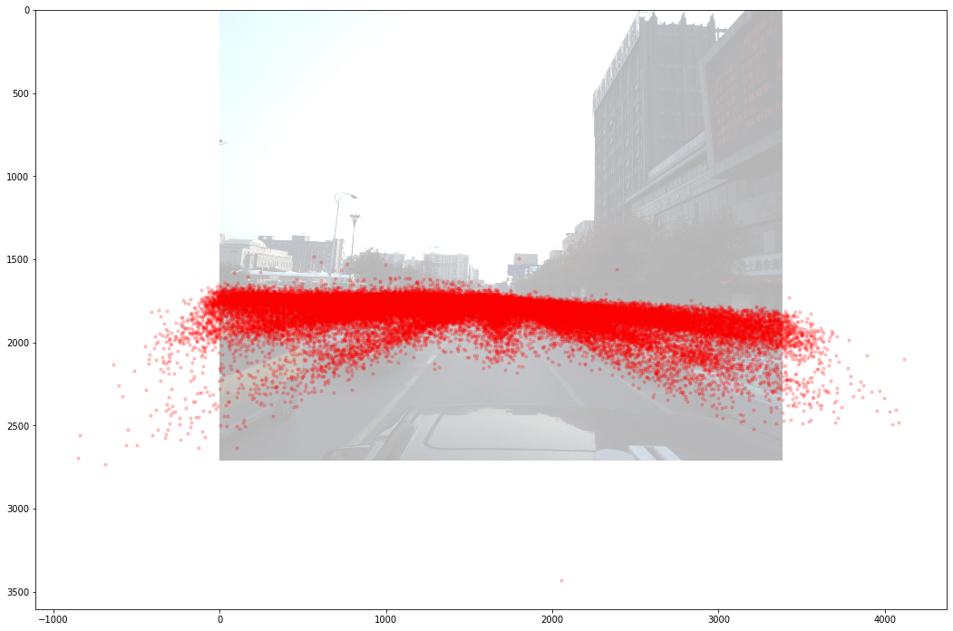

Slide 7
Experimental Setup
Resize image (keep same ratio):
Original Size: (2710, 3384, 3) > Cut the top Half (Since in all images, the top half part is sky) then, in order to keep the same ratio, keep the height then padding with mean of the image to generate background. Left padding with of ⅛ width, right padding fill in rest width to 2048 pixels.
After Resize: (640, 2048, 3)
Get Mask and regression:
based on the resized image, find the each car on the new resized image and its 6D regression pose.
Hyperparameter tuning:
Batch Size = 4, Epoch = 10

Slide 8
Related Works
You Only Look Once: Unified, Real-time Object Detection
https://arxiv.org/abs/1506.02640
EfficientNet: Rethinking Model Scaling for Convolutional Neural Networks
https://arxiv.org/abs/1905.11946
EfficientDet: Scalable and Efficient Object Detection
https://arxiv.org/abs/1911.09070
Feature Pyramid Networks for Object Detection
https://arxiv.org/abs/1612.03144

Slide 9
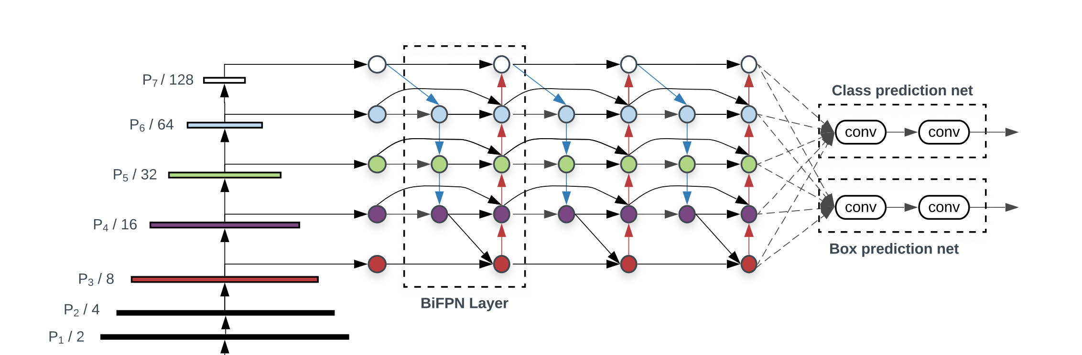
Deep Learning Network

Slide 10
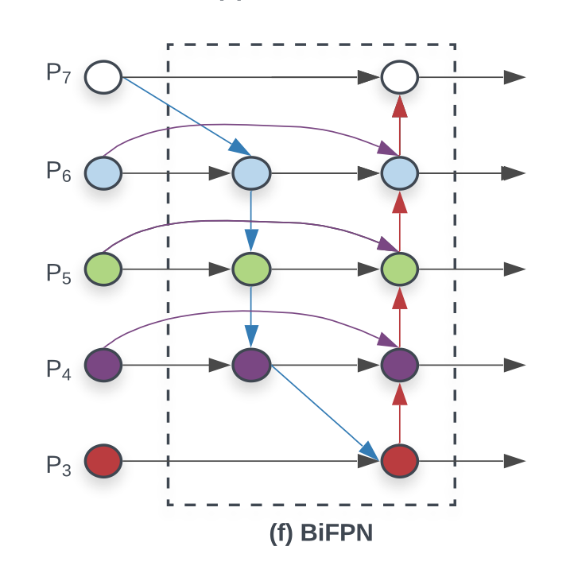
Deep Learning Network

Slide 11
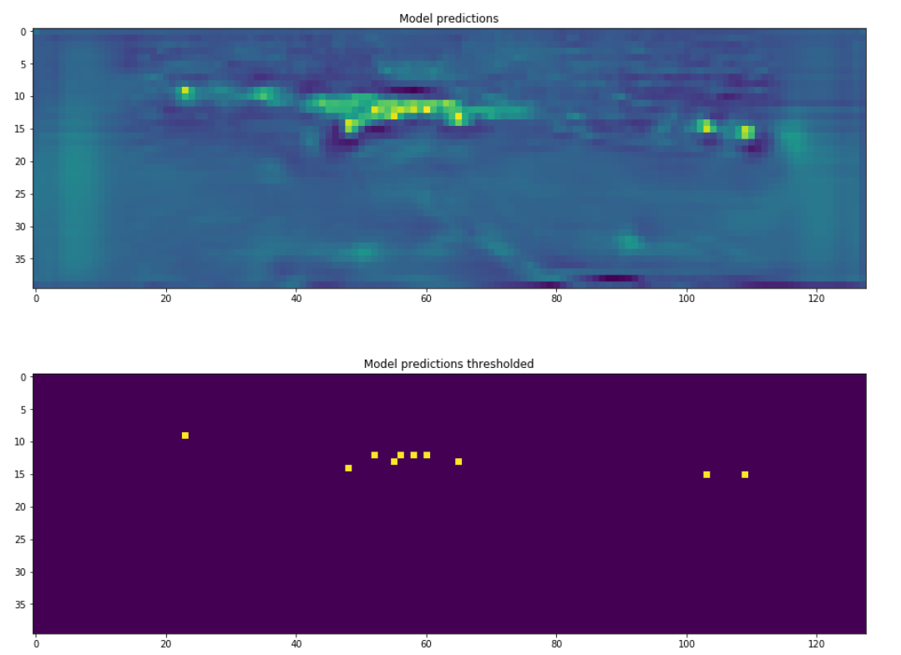
Results

Slide 12
Summary and Conclusion

